Slide 1
USRP implementation of multi static meteor radar transmit and receive applications
MIT Haystack Observatory -Program Research
Alexander Valdez Portocarrero
July 22 2019

Slide 2

OUTLINE
Implementation of Multistatic Radar for Meteor Detection
Documentation and Starting
Hardware and Software available.
Acquisition
Transmission
Analyze
Test and Processing
GNURADIO Companion
Experiment and Meteor Campaign
Results
Conclusion and Recommendation.

Slide 3
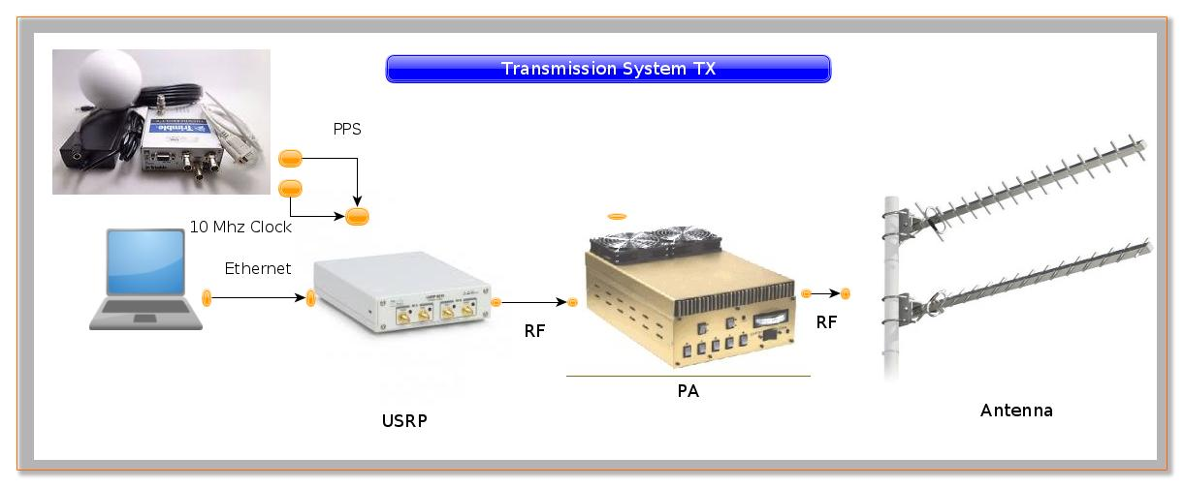
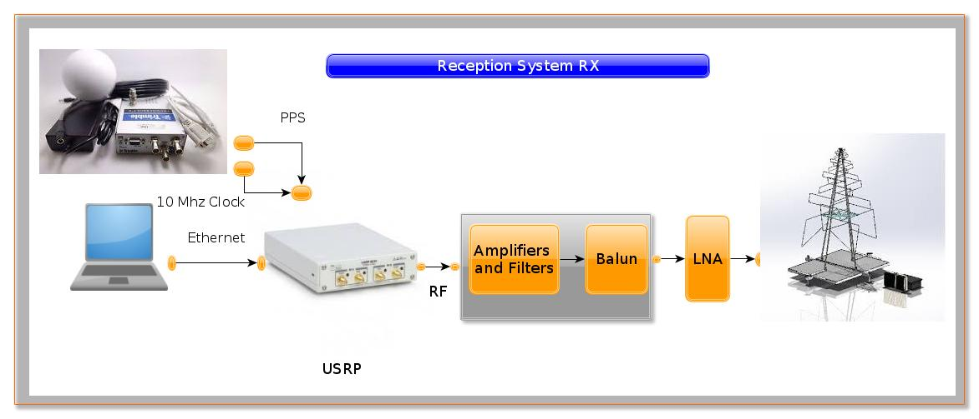
Implementation of Multistatic RadarMeteor Detection
MIMO
MISO
SIMO
SISO

Slide 4
Documentation and Start
Coded continuous wave meteor radar
Juha Vierinen 1 , Jorge L. Chau 2 , Nico Pfeffer 2 , Matthias Clahsen 2 , and Gunter Stober 2
1 MIT Haystack Observatory, Route 40 Westford, 01469 MA, USA
2 IAP,Kühlungsborn, Germany
Novel specular meteor radar systems using coherent MIMO techniques to study the mesosphere and lower thermosphere
Jorge Luis Chau 1 , Juan Miguel Urco 1 , Juha Pekka Vierinen 2 , Ryan Andrew Volz 3 , Matthias Clahsen 1 , Nico Pfeffer 1 , and Jörg Trautner 1
1 Leibniz Institute of Atmospheric Physics at the University of Rostock,Germany
2 UiT Arctic University of Norway, Norway
3 MIT Haystack Observatory, USA
Radio Array of Portable Interferometric Detectors(RAPID) : Design and Applications
Frank D. Lind, Colin J. Lonsdale, Ryan Volz, Anthea Coster, Chris Eckert, Russ McWhirter, Jim Marchese,
Robert Schaefer, William Rideout, Reggie Wilcox
Haystack Observatory- Massachusetts Institute of Technology
Digital RF 2.0
Juha Vierinen, William Rideout, Frank Lind, Robert Schaefer
A multistatic HF beacon network for ionospheric specification in the Peruvian sector
D. L. Hysell M. A. Milla J. Vierinen

Slide 5
Hardware and Software available
Hardware available:
USR N310
URSP N200 + BASIC RX
USRP N200 + UBXN40
Software available
Gnuradio
Uhd
https://kb.ettus.com/Building_and_Installing_the_USRP_Open-Source_Toolchain_(UHD_and_GNU_Radio)_on_Linux
Digital_rf
https://github.com/MITHaystack/digital_rf
Programs: thor.py , tx.py , prc_analyce.py, drf_plot.py and create_waveform.py

Slide 6
ACQUISITION
THOR.py
gnuradio-config-info -v
3.7.13.4
Sistema Operativo
LSB Version: core-9.20170808ubuntu1-noarch:security-9.20170808ubuntu1-noarch
Distributor ID: Ubuntu
Description: Ubuntu 16.04 LTS
Release: 16.04
Codename: xenial
Ubicacion:
/home/alex/HaystackOP/
uhd_config_info --v
UHD 3.14.0.HEAD-0-g6875d061
-m 192.168.10.2 -d "A:0" -c ch1 -y "TX/RX" -f 20e6 -F 10e3 -g 20 -b 0 -r 1e6 /data/test
ARGUMENTOS DE ENTRADA |  | ESCRITURA EN METADATA
-m | MBOARD | sequence_num
-d | subdev | num_subchannels
-c | CH | sample_rate_numerator
-f | Frequency | samples_rate_denominator
-F | OFFSET | init_utc_timestamp
-g | Gain | computer_time
-b | Bandwidth
-r | rate
DIR | Path

Slide 7
TRANSMISION
tx.py
gnuradio-config-info -v
3.7.11
Sistema Operativo
LSB Version: core-9.20170808ubuntu1-noarch:security-9.20170808ubuntu1-noarch
Distributor ID: Ubuntu
Description: Ubuntu 18.04.1 LTS
Release: 18.04
Codename: bionic
Ubicacion:
/home/soporte/GNURADIO_TX/uhd/host/examples/python/
uhd_config_info --v
UHD 3.14.0.0-269-g11bbc3c0
python tx.py -m 172.16.5.189 -r 1e6 -f 25.0e6 -d "A:0" -y "TX/RX" -G 1 -g 33 -b 40e6 -l 1 --starttime 2019-07-10T13:05:00Z --duration 240 --sync_source "external" /home/alex//sounder/waveforms/code-l10000-b10-000000.bin
ARGUMENTOS DE ENTRADA
-m
-f | freq
-r | rate
-d | subdev
-c | channels
-g | gain
--sync | external
-l | duration
-File | File

Slide 8
ANALYZE
prc_analyze.py
create_pseudo_random_code(clen=10000, seed=0)
periodic_convolution_matrix(envelope, rmin=0, rmax=100)
create_estimation_matrix
Nranges Number of code(code, rmin=0, rmax=1000, cache=True):
res= (1000,10000)* z
Z= Data of our hdf5 file. (10000)
We get res(100,1000), and finally ---> After fft----> SPEC
100 profiles
1000 Nranges

Slide 9
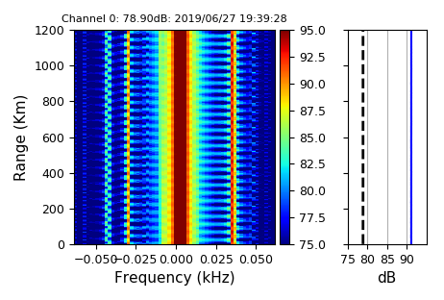
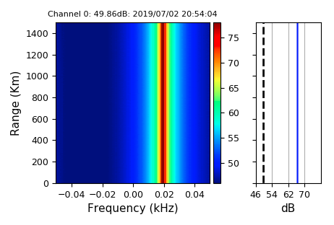
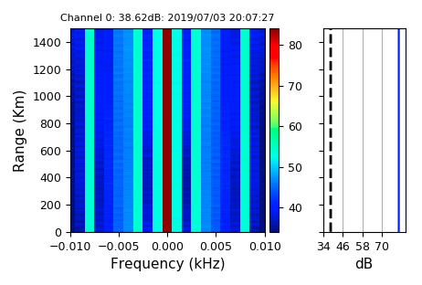
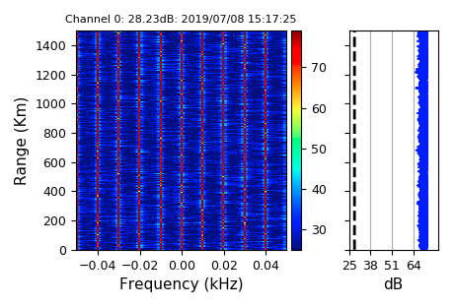
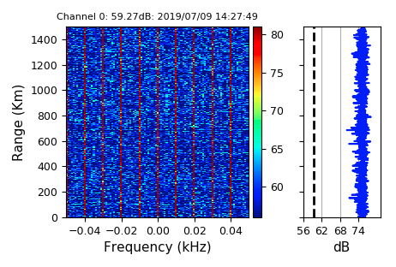
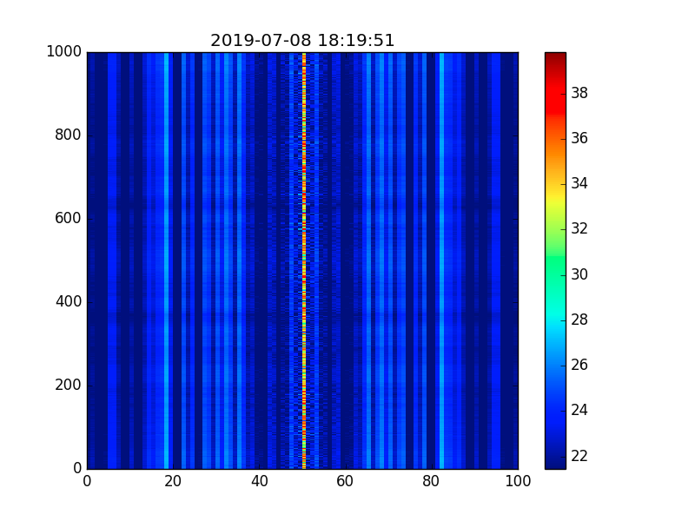
TEST AND PROCESSING
PRC_ANALYZE.py

Slide 10
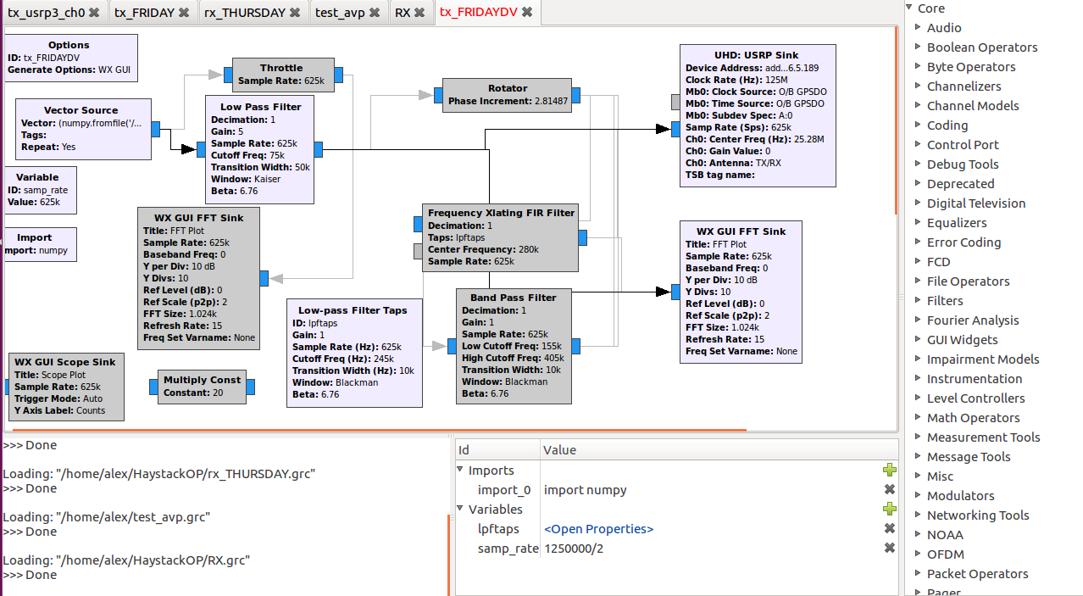
GNURADIO-COMPANION

Slide 11
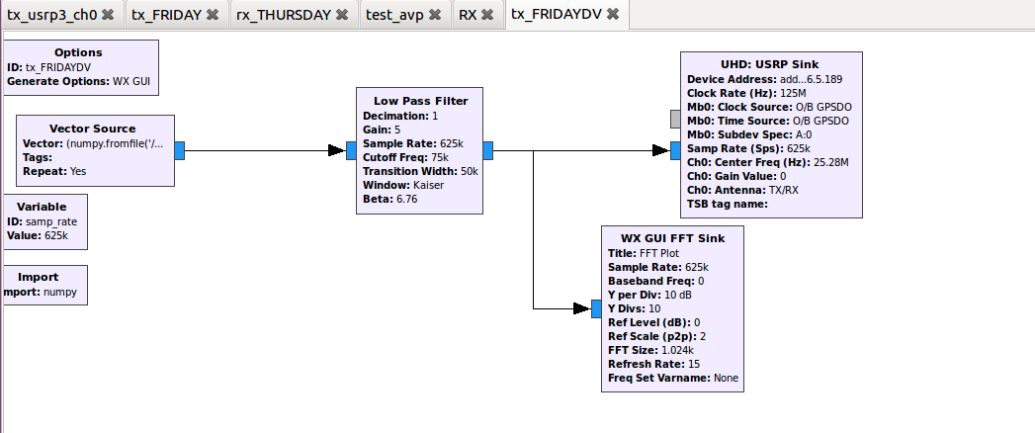
EXPERIMENT-METEOR CAMPAIGN
Rx: Thor.py
Tx: Gnuradio companion
Processing: prc_analyze.py
Tx_Program-GNURADIO- COMPANION

Slide 12
PARAMETER OF EXPERIMENT
Parameter | SIMO -CW
Frequency | 25.280 MHz (11.859 meters / 38.9074803 feet)
Transmitter | 250 kHz (out of 500 kHz licensed band), target ERP is 1W with antenna. 1 Transmitter
Pulse Type | Coded CW
Code length | 10000 (Oversample by a factor of 5)
Code Type | Pseudorandom
Rx | Digital RF target recording bandwidth is 250 kHz. For N310, sample at 25.0 MHz with 1.25 MHz of bandwidth, use thor to offset tune 25.280 MHz and produce 250 kHz output as sc16 integer data
Receiver | a. Haystack Array Pad site with LWA-R antenna, MIT LWA-R LNA, and N310 radio (dual polarization) b. Haystack Office Lab site with LWA-R antenna and N310 radio (dual polarization) c. Lind LWA-R site (N200 radio, 30 MHz LPF, dual polarization)

Slide 13
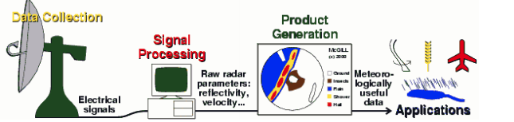
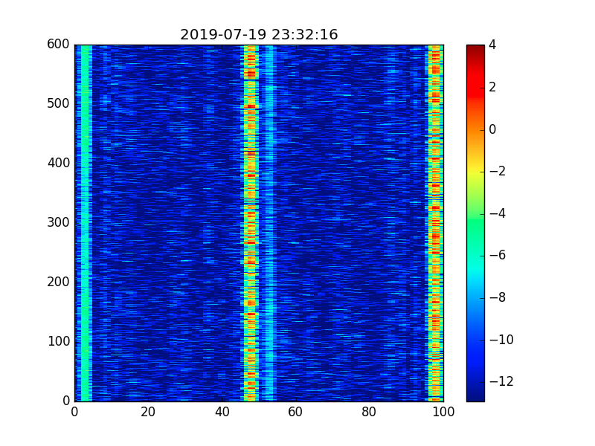
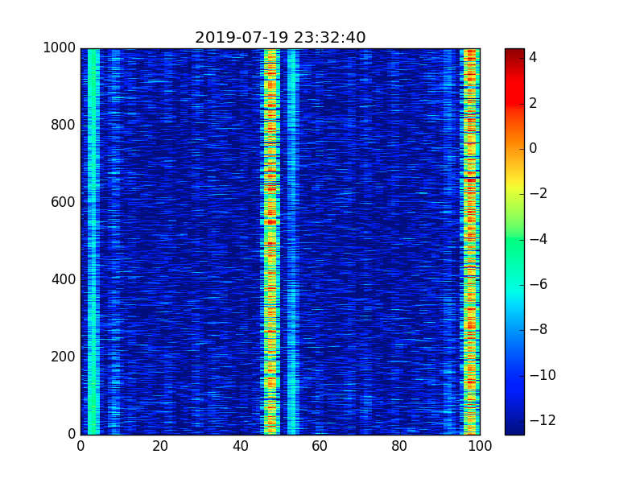
PROCESSING AND RESULT

Slide 14
CONCLUSIONS AND RECOMMENDATION
Run a Meteor Campaign with all instrument available is posible we need to do more test.
SDR and GNURADIO in general are a powerfull tool to rapid prototyping and implementation.
Test in laboratory with the 25.280 Mhz and repeat the experiment with more Power.
Learn more about code continuous wave meteor radar.
Design a program to acelerate and setup the configuration in USRP N310.
Design a Web Application for Monitoring SDR in general.

Slide 15


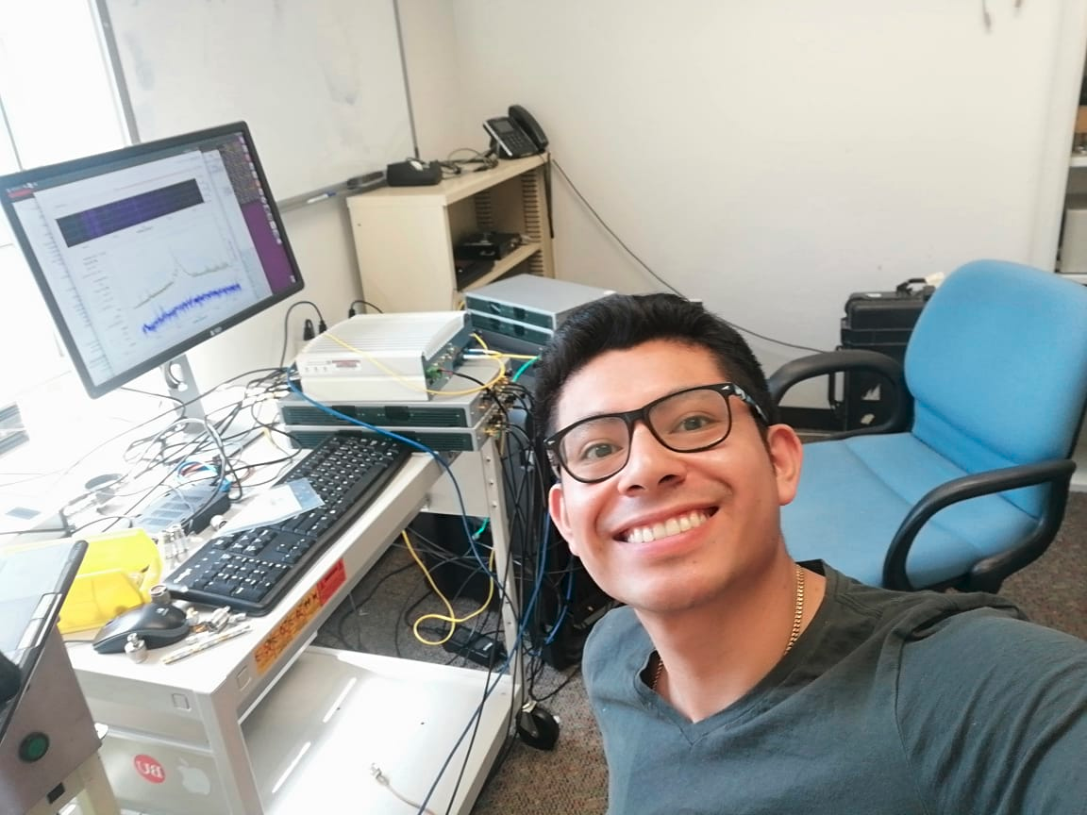

Happyness

Slide 16
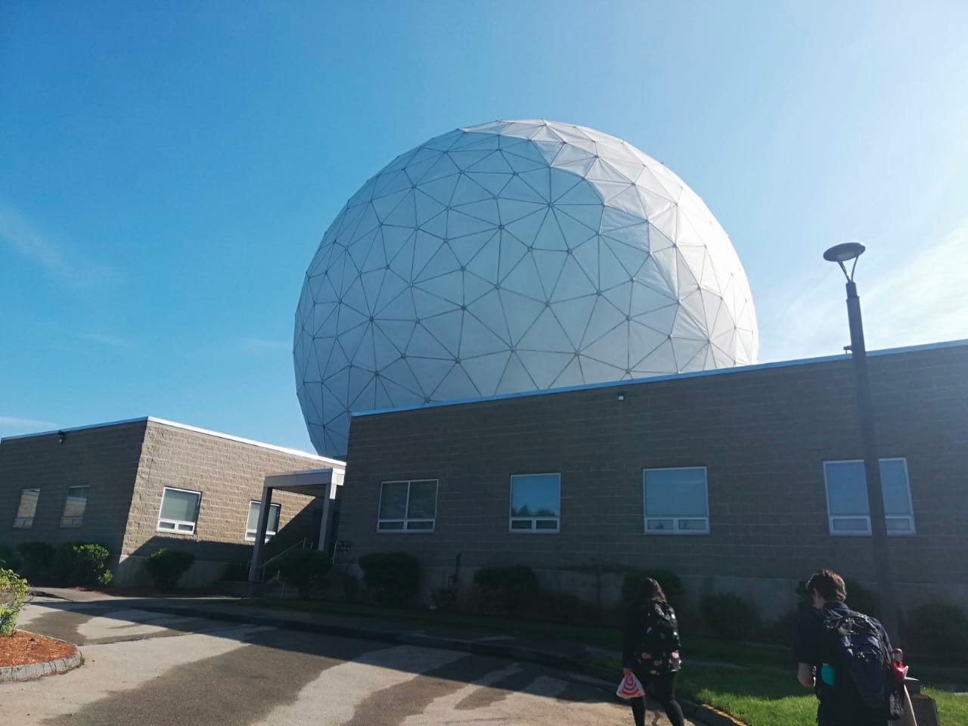
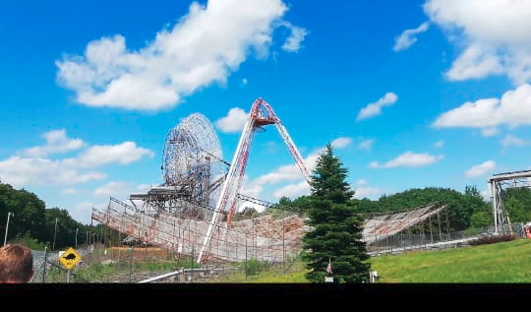




WONDERFUL INFRASTRUCTURE

Slide 17
Thank you!
Ciencia para protegernos,
ciencia para avanzar.
www.igp.gob.pe

